Slide 1

Unit 3: Lesson 2 You are what you eat
U ovoj ćeš lekciji upotrijebiti glagolsko vrijeme the present perfect u kontekstu superhrane i zdrave prehrane.

Slide 2
Open your book, page 52
Task 1: What is the correct definition of superfood?
Task 2: Match the names of superfoods with the pictures.
Task 3: Have you ever tried any of these superfoods?
legumes
nuts
ginger
seaweed
legumes = mahunarke salmon = losos
nuts = orašasti plodovi kale = kelj
ginger = đumbir kefir = kefir
seaweed = alge avocado = avokado
blueberries = borovnice
blueberries
salmon
kale
kefir
avocado

Slide 3
Task 4: Complete the text with the words from the box.
ever
since
just
never
for
already
yet

Slide 4
Present perfect
We use the present perfect to talk about things we have done up to now.
Form: have/has + past participle (verb + d/ed)
Irregular verbs have special forms (see – saw – seen).
I have never tried seaweed.
Have you ever been to a workshop before?
She hasn’t seen him since the accident.
We use the present perfect with adverbs like ever, never, already, just, yet, since and for.

Slide 5
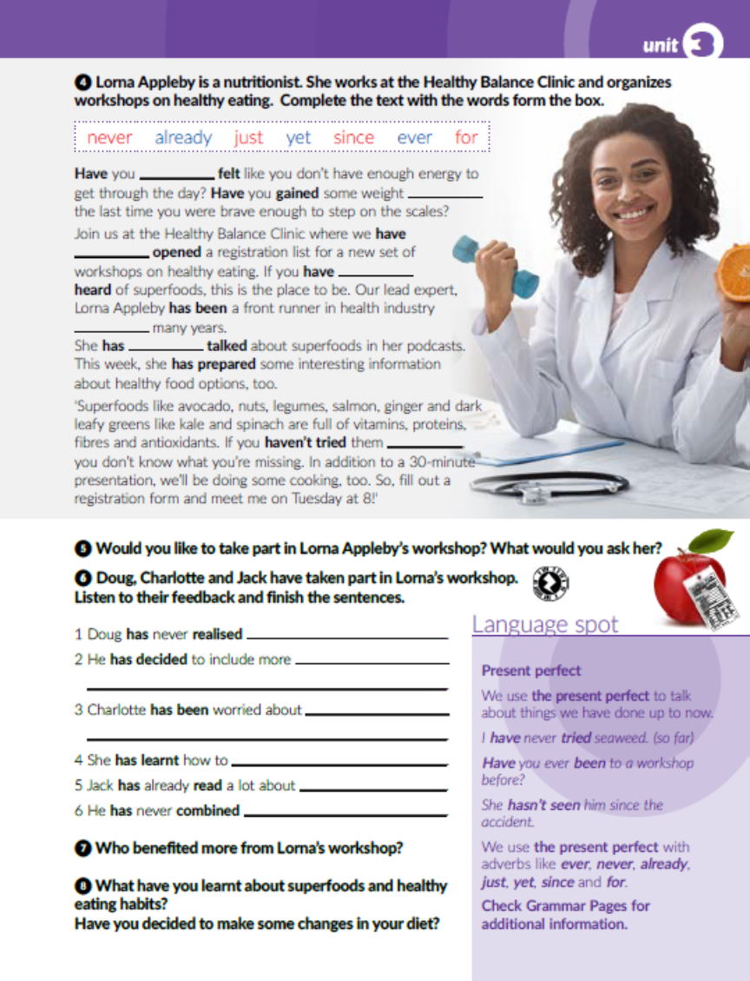
Task 6: Doug, Charlotte and Jack have taken part in Lorna’s workshop. Listen to their feedback and finish the sentences.
https://www.e-sfera.hr/dodatni-digitalni-sadrzaji/21e0b0af-663f-45b9-993b-6e50aa968c64/
how bad his diet was.
fish, legumes and berries in his diet.
her children’s eating habits.
prepare healthy and well-balanced meals.
superfoods.
seaweed with chickpeas before.

Slide 6

Task 7: Who benefited more from Lorna’s workshop?
Task 8: What have you learnt about superfoods and healthy eating habits?

Slide 7
Open your workbook, page 51
Task 1: Match the superfoods to their definitions.
2
4
7
5
6
3
9
8

Slide 8
Task 2: Write a healthy meal plan for seven days of the week.

Slide 9
Task 3: Complete the sentences with the words from the box.
ever
just
since
yet
for
never

Slide 10
Task 4: Complete the table with correct forms of irregular verbs.
bought
bought
draw
drawn
fight
fought
froze
frozen
forget
forgot
know
known
lit
lit
ring
rang
see
seen
shook
shaken
sink
sunk
speak
spoke
stand
stood
thought
thought
understand
understood
write
wrote

Slide 11
Task 5: Complete the dialogue using the present perfect simple of the verbs in brackets.
haven’t complained
have produced
have been
haven’t slept
Have tried
Have talked
haven’t taken
Have thought
have wanted
have seen
haven’t decided
Have asked
have come
haven’t given

Slide 12
Task 6: Interview your mum, dad, sibling or a friend and tick his/her answers.
Task 6: Write a report.

Slide 13
Task 8: Complete the text using the present simple, the present continuous, the past simple, the past continuous or the present perfect.
has read
has probably seen
has watched
is
have been / are
bought
was jumping
realised
has become
has won
met
got
were talking
kept
decided
finishes
is trying
is
wants
happened
is giving
doesn’t like
isn’t
do think
is doing
is standing
looking

Slide 14

Otvori sljedeću poveznicu, te odaberi PLAY AND LEARN!
https://www.e-sfera.hr/dodatni-digitalni-sadrzaji/21e0b0af-663f-45b9-993b-6e50aa968c64/

